Slide 1
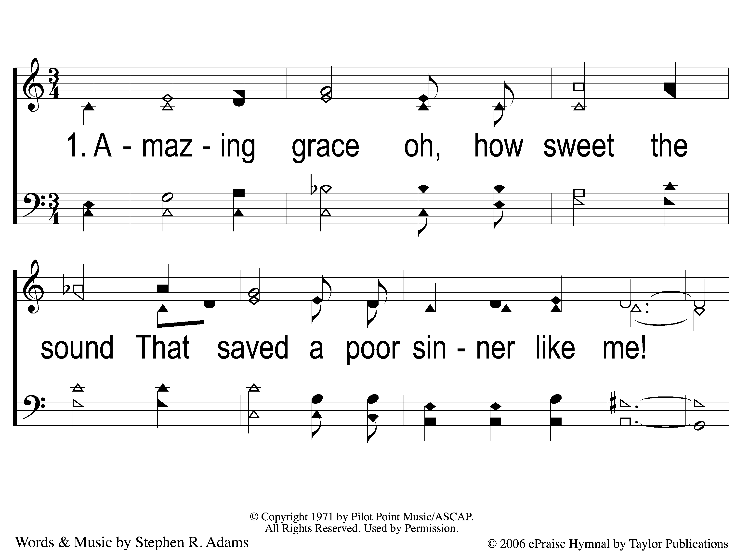
1-1 All Because of God’s Amazing Grace
All Because of God’s Amazing Grace
327

Slide 2
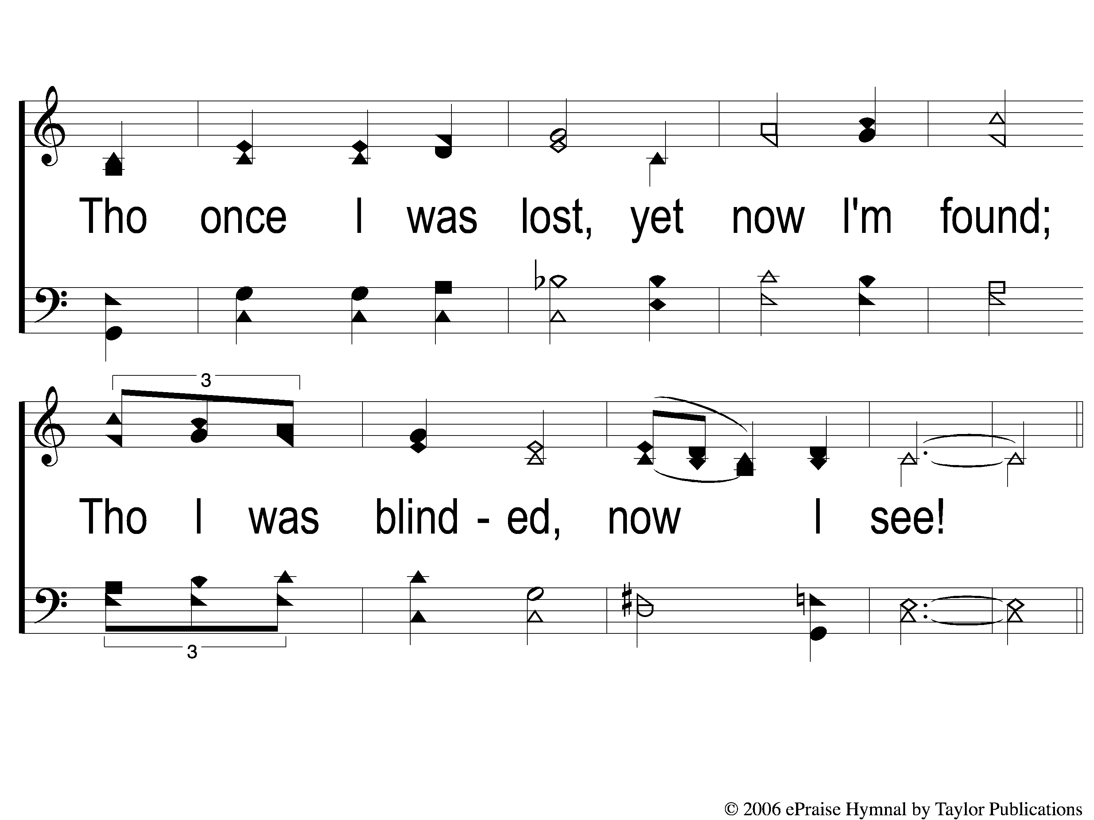
1-2 All Because of God’s Amazing Grace
All Because of God’s Amazing Grace
327

Slide 3
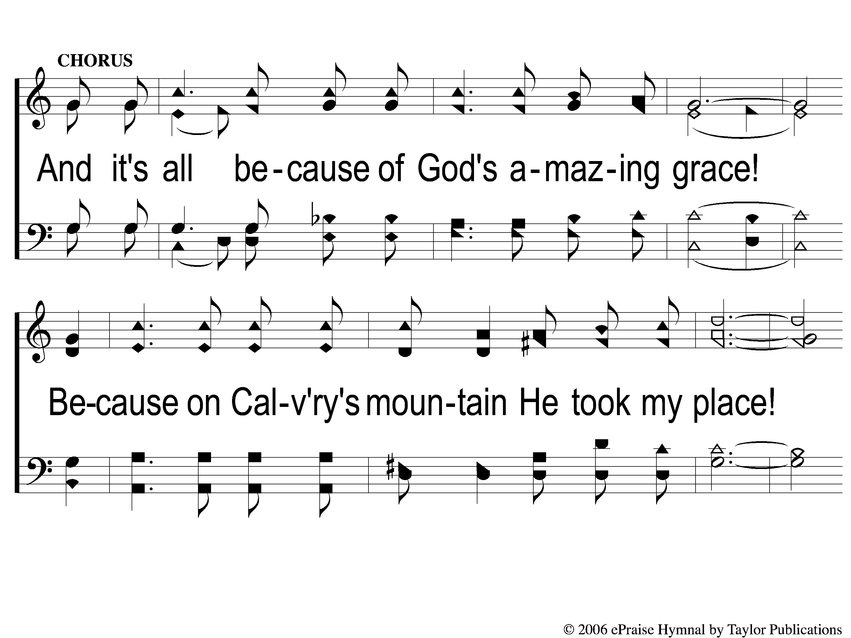
C-1 All Because of God’s Amazing Grace
All Because of God’s Amazing Grace
327

Slide 4
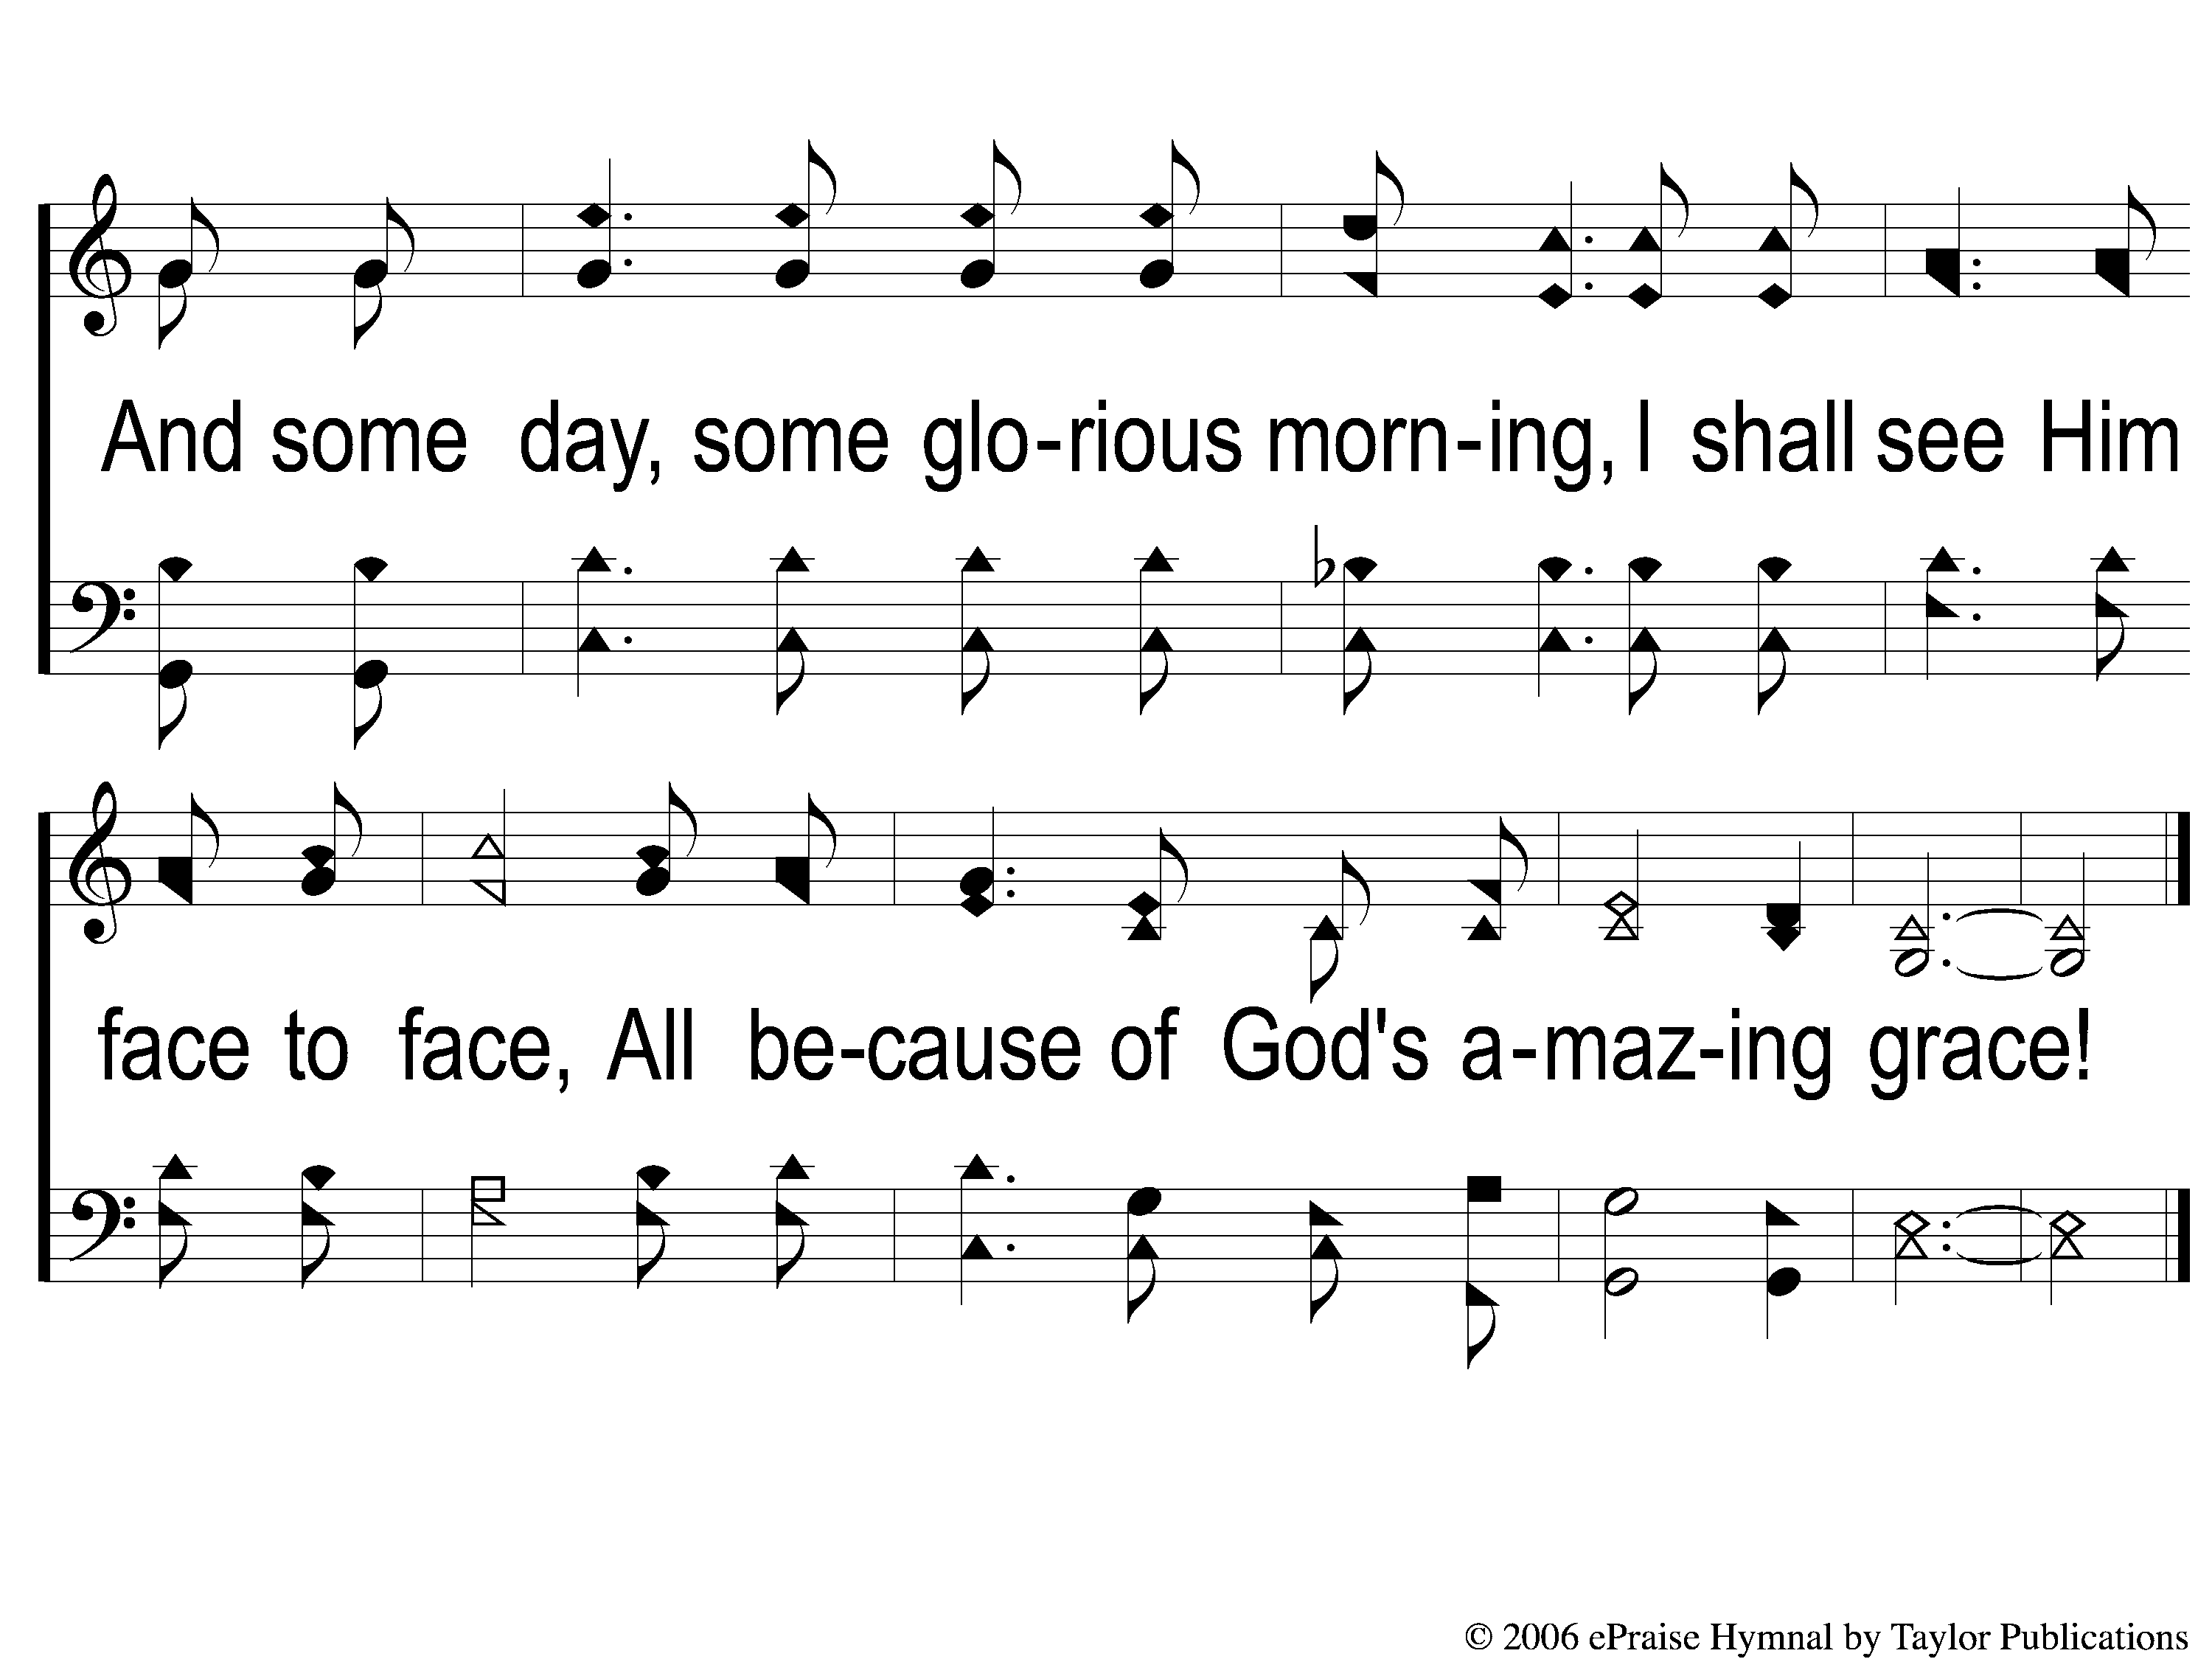
C-2 All Because of God’s Amazing Grace
All Because of God’s Amazing Grace
327

Slide 5
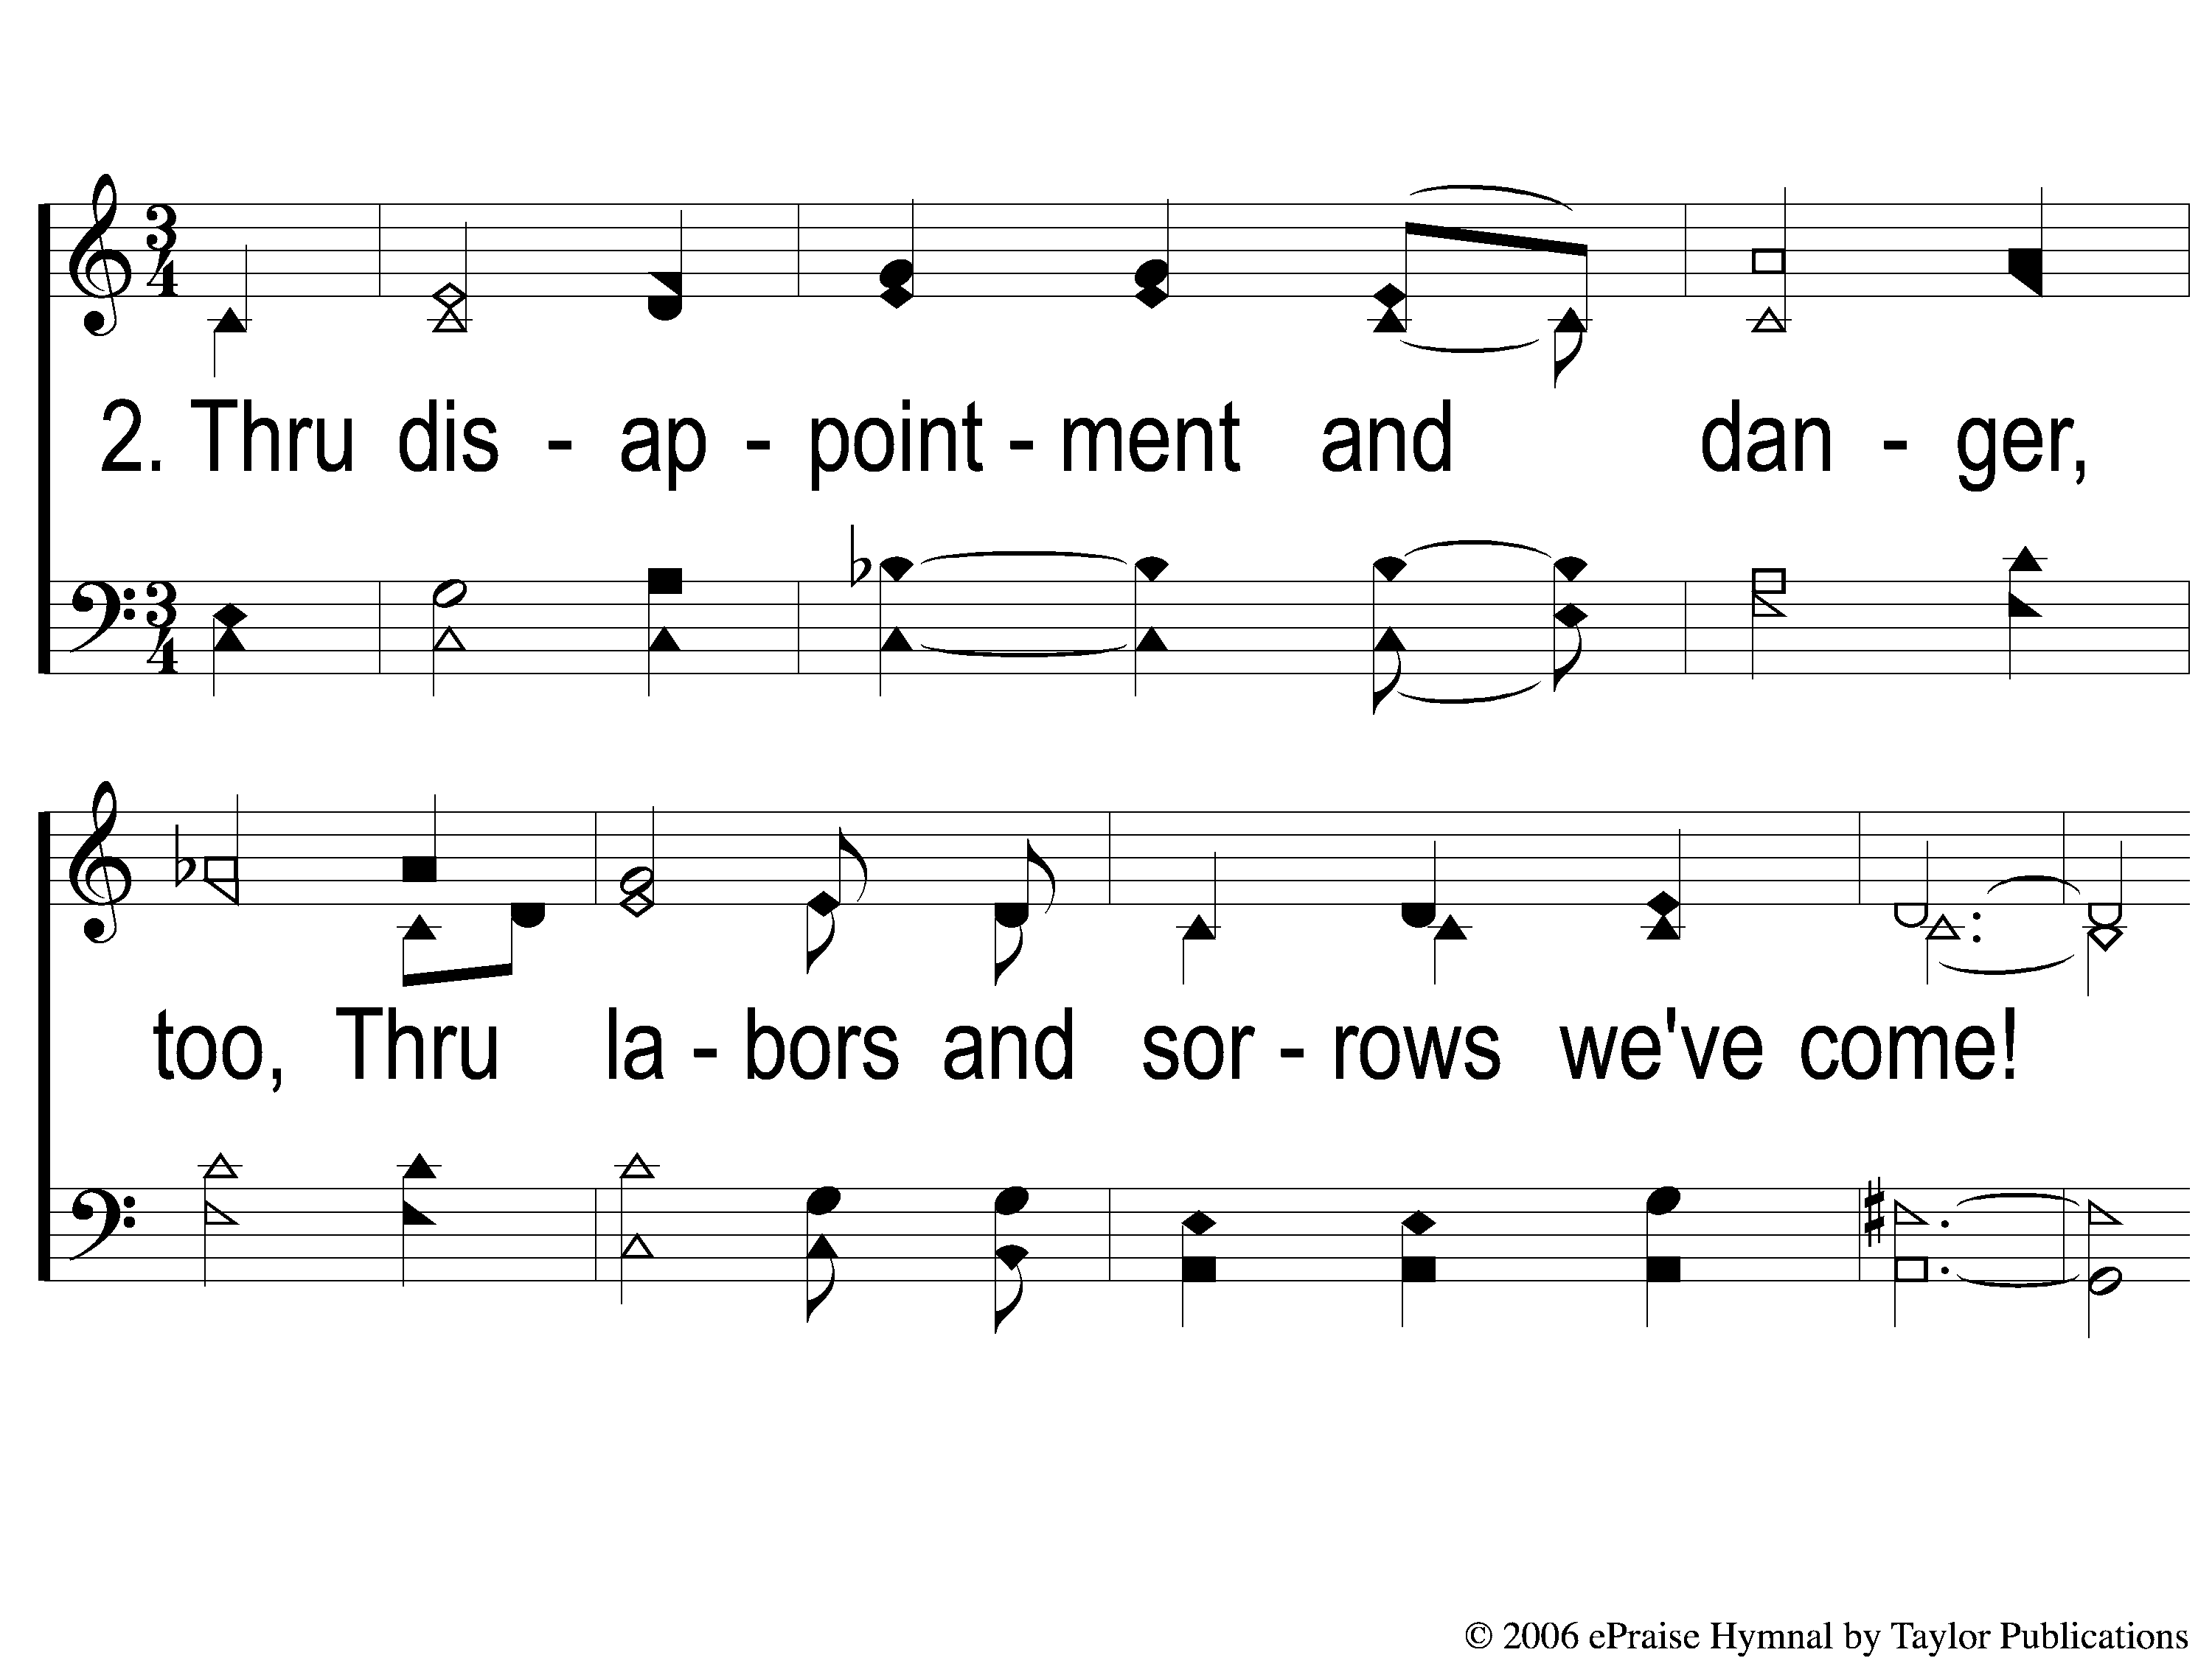
2-1 All Because of God’s Amazing Grace
All Because of God’s Amazing Grace
327

Slide 6
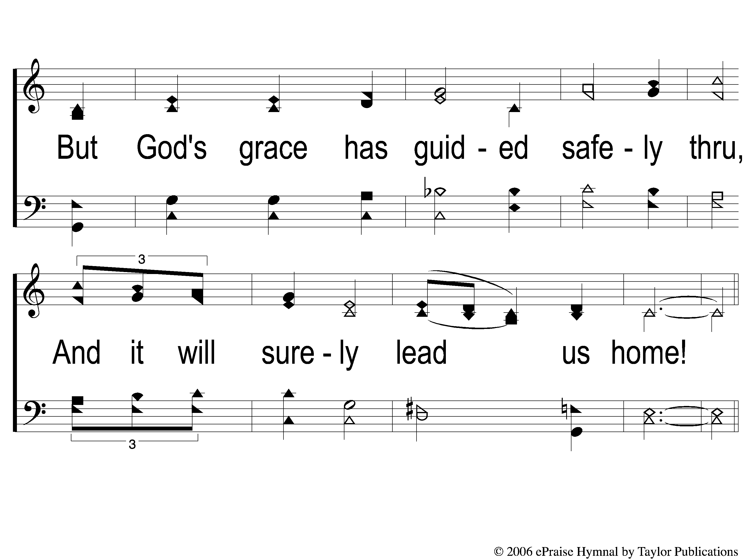
2-2 All Because of God’s Amazing Grace
All Because of God’s Amazing Grace
327

Slide 7
C-1 All Because of God’s Amazing Grace
All Because of God’s Amazing Grace
327

Slide 8
C-2 All Because of God’s Amazing Grace
All Because of God’s Amazing Grace
327

Slide 9

3-1 All Because of God’s Amazing Grace
All Because of God’s Amazing Grace
327

Slide 10
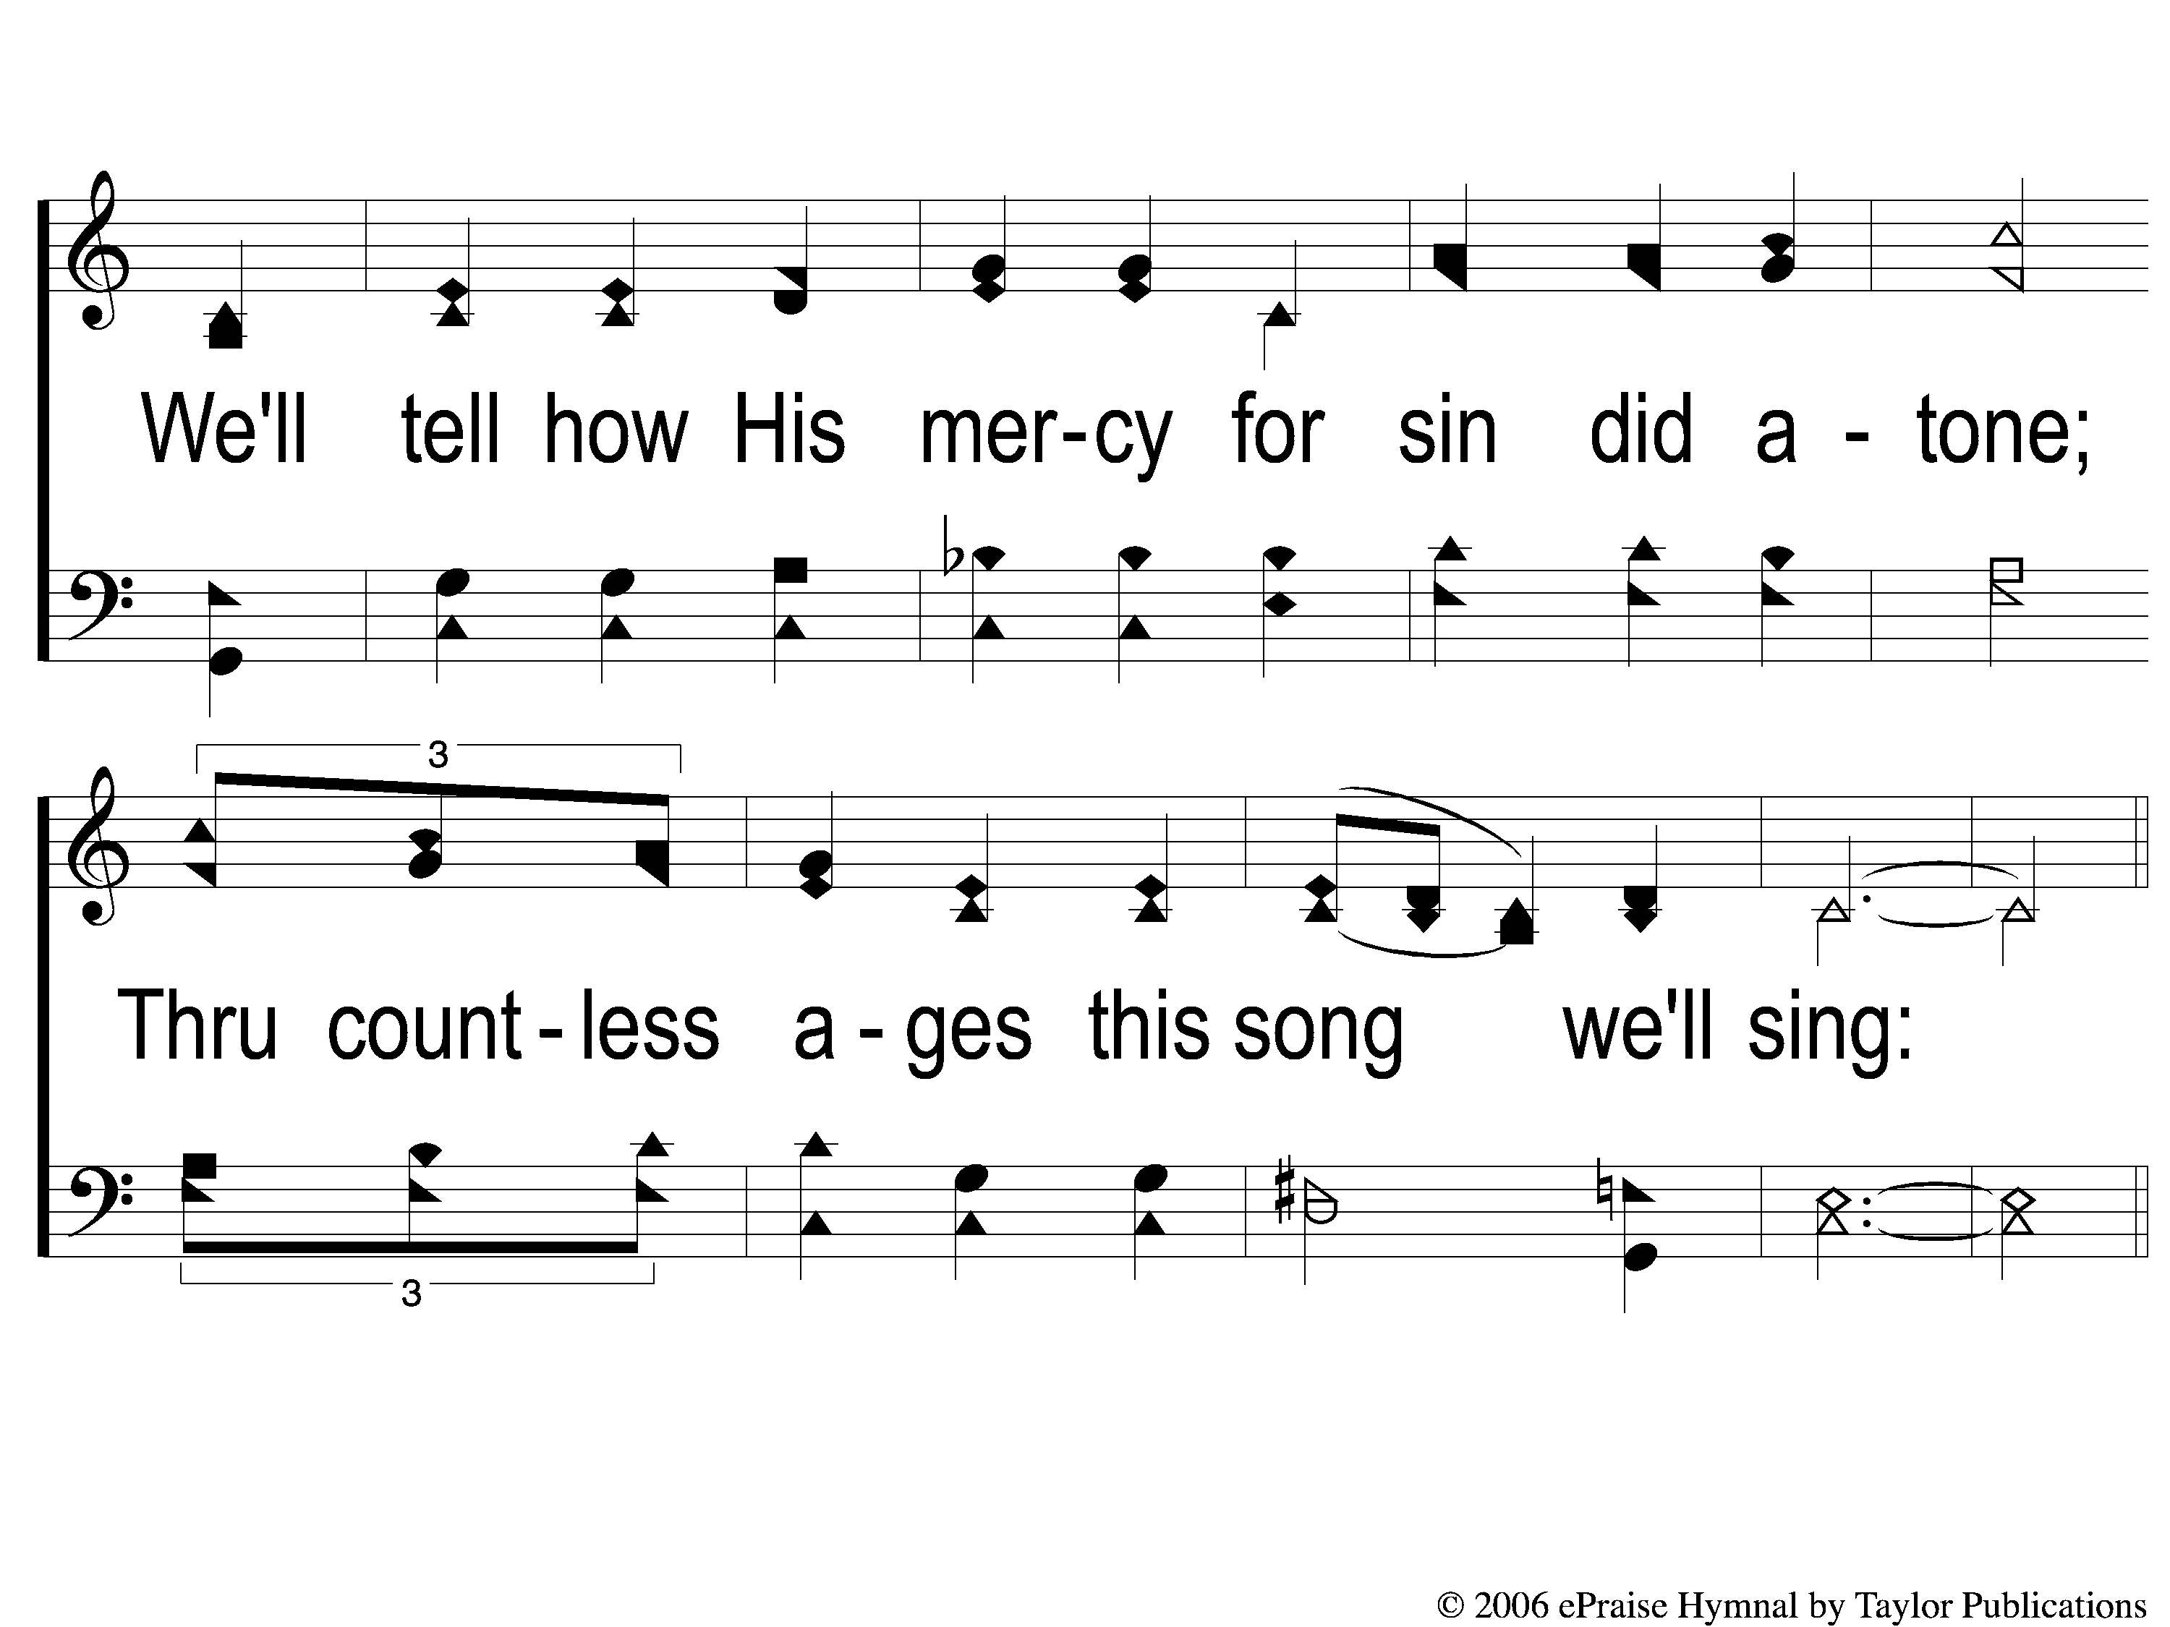
3-2 All Because of God’s Amazing Grace
All Because of God’s Amazing Grace
327

Slide 11
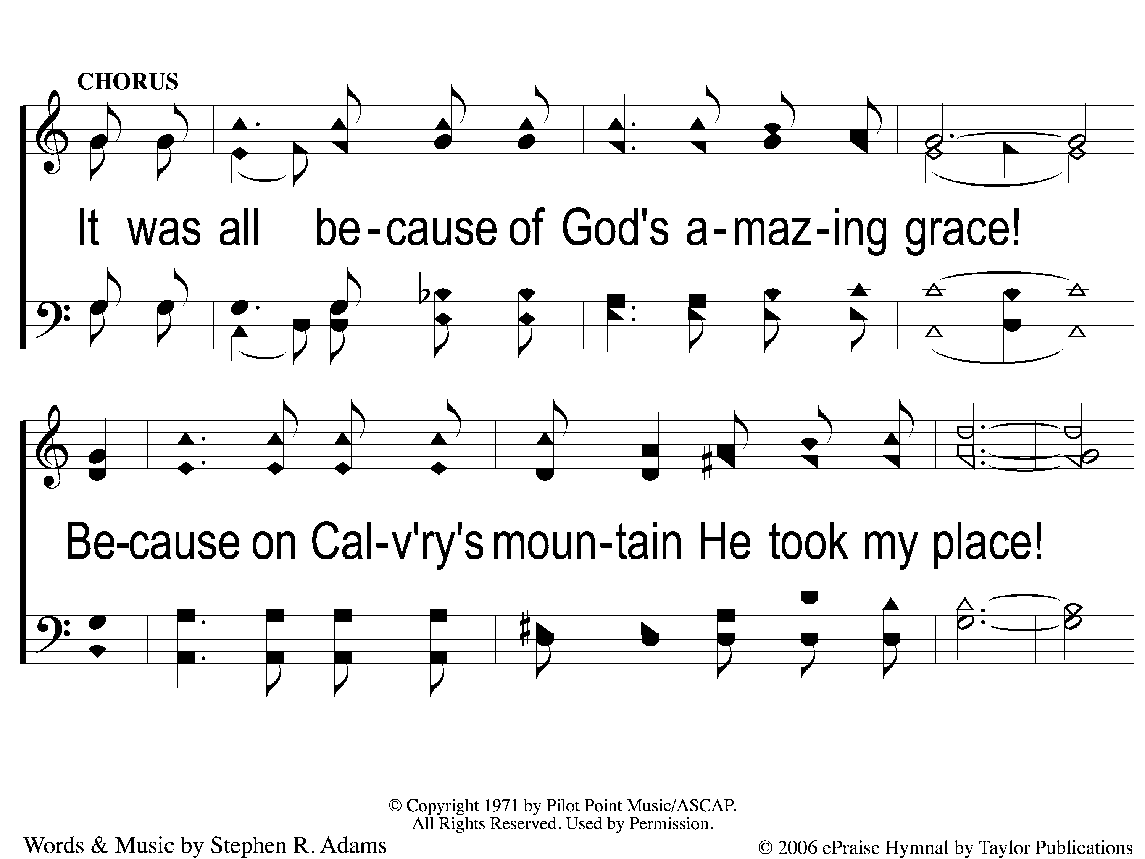
2C-1 All Because of God’s Amazing Grace
All Because of God’s Amazing Grace
327

Slide 12
2C-2 All Because of God’s Amazing Grace
All Because of God’s Amazing Grace
327

Slide 13
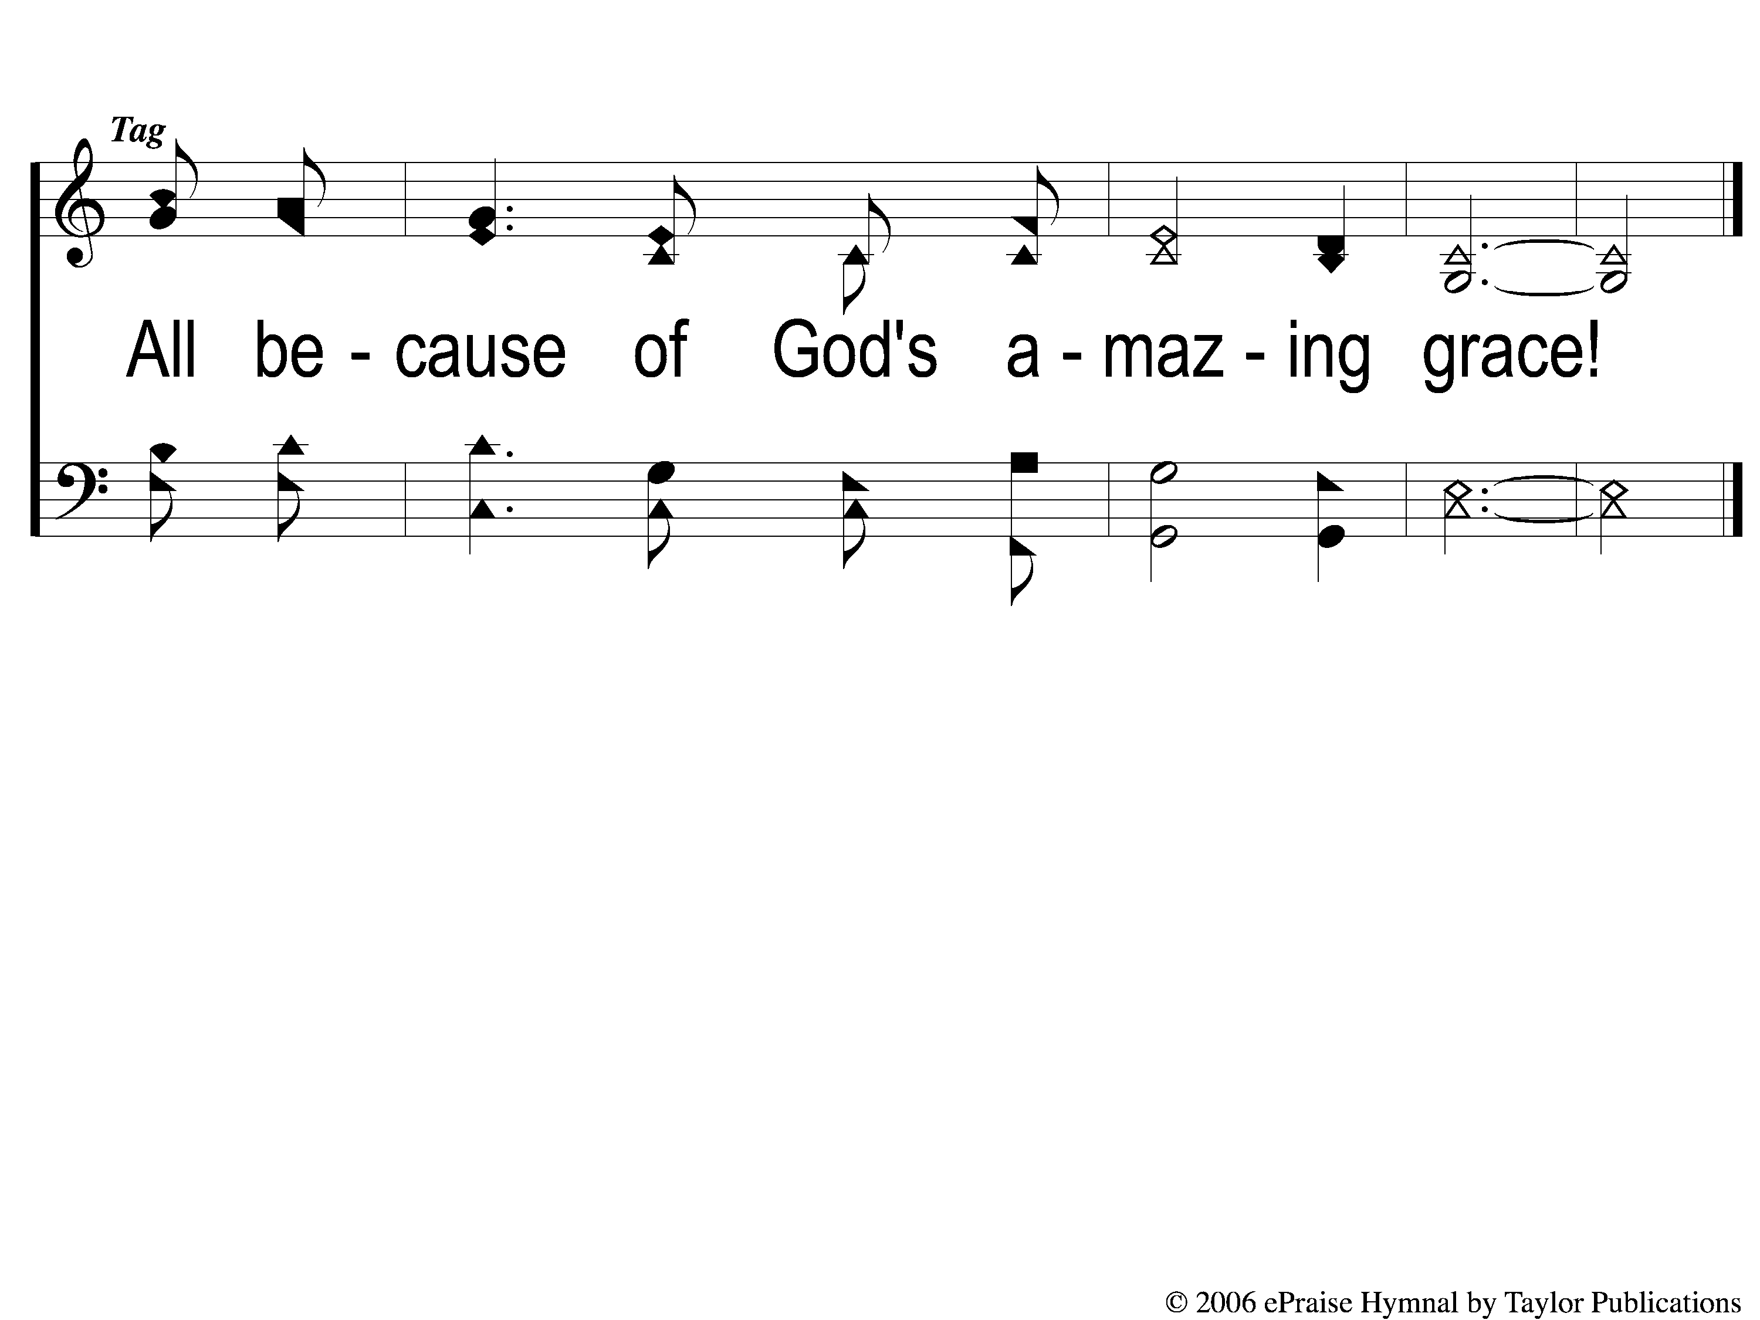
Opt tag All Because of God’s Amazing Grace
All Because of God’s Amazing Grace
327

